Slide 1
Project Imagine

Slide 2
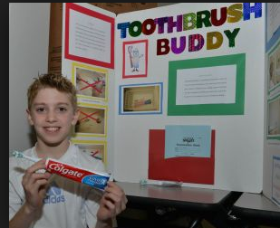
Display Board
Essay
Sketches
Title
Pictures

Slide 3
Title of Invention
How It Works
Sketch
Essay
picture
picture
picture

Slide 4
Beautiful Work
Nothing written by hand – print or use stencils
Color!!!
Straight lines – use paper cutter
Glue straight
Less is more – don’t overwhelm with too many pictures, different types of font

Slide 5
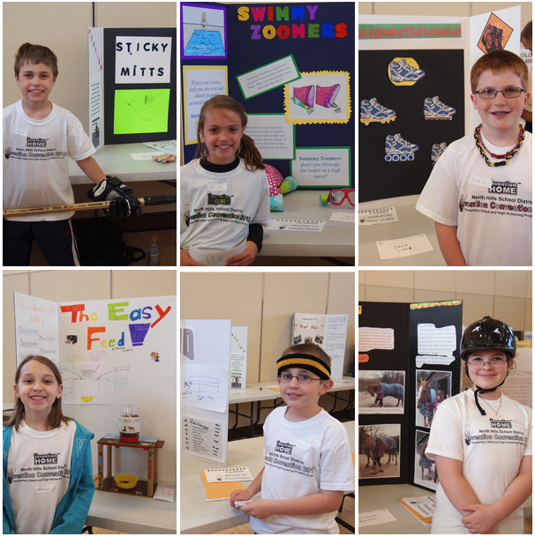

Slide 6
Essay Questions
What is the problem you are trying to solve? Why is this a problem in your life?
What is your innovation called? Why did you give it this name? What is your innovation and how does it work? (This section should give detailed steps as to how it works)
Explain your brainstorming process for this project. What problems did you think of and why did you choose the problem you did? What different innovations did you design before choosing your final design? What different materials did you use before choosing the ones you did? Why did you choose these materials?
How does your innovation solve your problem? How does it make your life easier? Who else would benefit from your innovation?

Slide 7
Learning Scale
4 – Project went above level 3 criteria.
3- All criteria is included in the project: display board with essay and sketch; prototype of invention is available. Board is professional looking and free of errors. Invention solves a problem.
2 – One of the level 3 criteria is not met.
1 – Two or more of the level 3 criteria is not met.

