Slide 1
Bridge Building
a sixth grade elective

Slide 2
The Bridge
Why is bridge building an important engineering topic?
Look at my bridge, it seems very simple.
Did I build a useful model, one that could be used for a real bridge?
Notes:
Teacher shows model of a beam bridge. Wood piers and two pieces of poster board for the deck/beam. Place a car on top

Slide 3
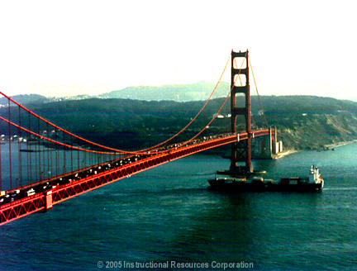
Notes:
Golden Gate bridge, suspension

Slide 4
Beam vs. Suspension
Why build the Golden Gate? Beam bridges are simple!!
What other types of bridges are there? Why so many different types?
Notes:
Types: beam, suspension, truss, tower, cable-stay

Slide 5
Notes:
Students answer four questions during video – see file

Slide 6
Coming Up…
We will be designing a bridge to cross a river.
Until then, keep this in mind.
What are the structural requirements of a bridge?
What forces and stresses do engineers consider when designing a bridge?
What are the advantages and disadvantages of the arch, the beam, and the suspension bridge?
What factors do engineers consider when they design a bridge?

